Slide 1



Risk Assessment Awareness Training
Laura Davies
DL Team Leader
SHE Group
Notes:
The abstract pattern can be removed or repositioned if required. Be careful to ‘Send to Back’ so that it does not obscure any important information.

Slide 2









How I became a health and safety advisor
BSc Hons Prosthetics & Orthotics, Strathclyde
Worked for NHS
BSc Hons Environmental Health, Strathclyde
Environmental Health Officer (EHO) for Moray and Midlothian Councils in Scotland
EHO, Auckland City Council, New Zealand
Taught on the EH degree course, Strathclyde University
Tesco Ireland, Trading Law Manager
STFC, 2014 onwards

Slide 3
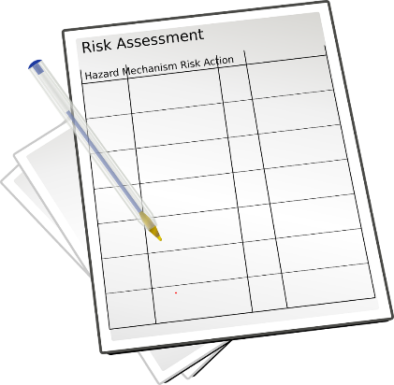
Session objectives
Introduction to the course
Where did risk assessment originate from?
Why is risk assessment important?
How to carry out an activity risk assessment
What makes a RA ‘suitable and sufficient’?
Good ole horror stories
Evotix Assure *live*

Slide 4
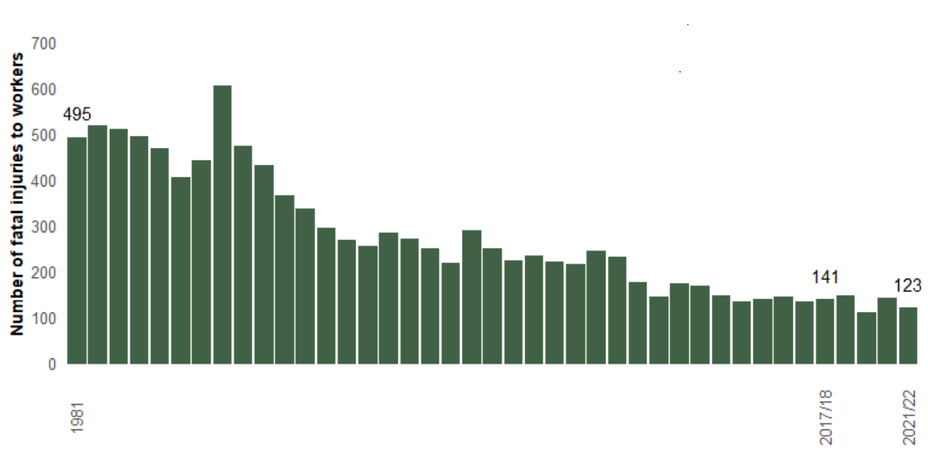
Introduction to the course
No. of fatal injuries to workers in GB from 1974 to 2021
1988 Piper Alpha 167 fatalities and Clapham train crash 35 fatalities
Focus previously was on physical hazards but health hazards kill more people annually

Slide 5
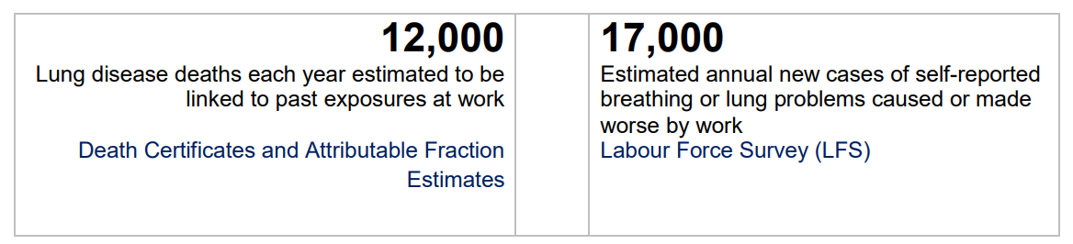

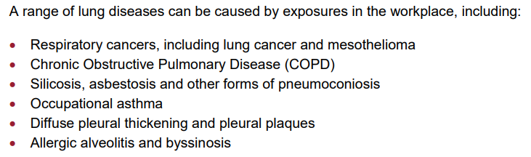

Slide 6
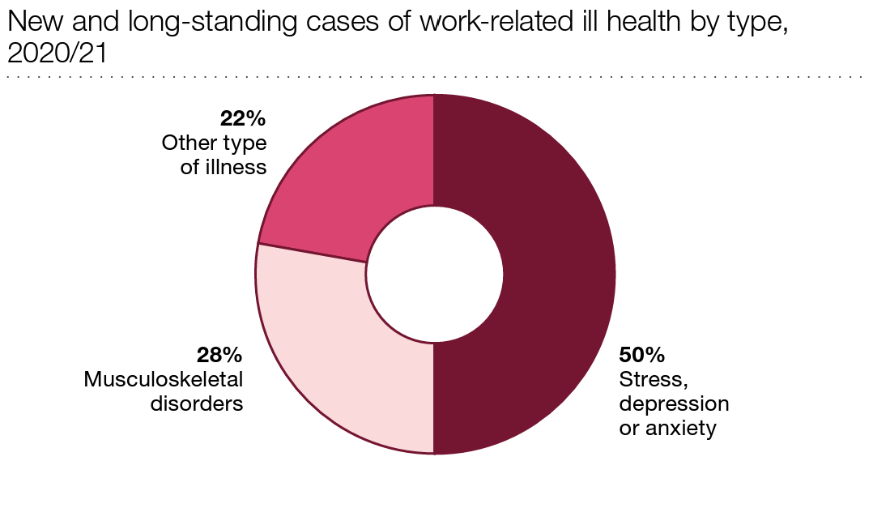
Introduction to the course
Remember these in your risk assessments

Slide 7

History of risk assessment
NASA, Apollo 1 test flight, January 27th 1967
Gus Grissom, Edward White and Roger Chaffee

Slide 8
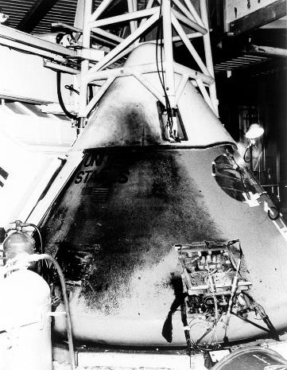
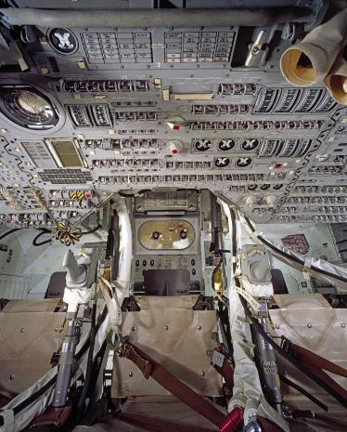
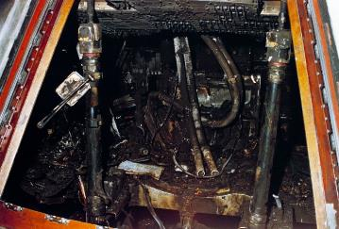
Investigation report
All 3 astronauts died from smoke inhalation
After this NASA applied the principles of RA to every activity and area of manufacture, i.e. what can go wrong? How do we prevent it?

Slide 9
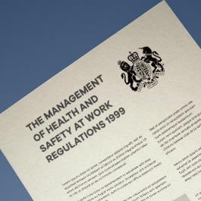
Risk assessment
3(1) Every employer shall make a suitable and sufficient assessment of -
  (a) the risks to the health and safety of his employees to which they are exposed whilst they are at work; and
  (b) the risks to the health and safety of persons not in his employment arising out of or in connection with the conduct by him of his undertaking,
(2) Every self-employed person shall make a suitable and sufficient assessment of -
(a) the risks to his own health and safety to which he is exposed whilst he is at work; and
(b) the risks to the health and safety of persons not in his employment arising out of or in connection with his undertaking, for the purpose of identifying the measures he needs to take to comply with the requirements and prohibitions imposed upon him by or under the relevant statutory provisions.
(3) Any assessment such as is referred to in paragraph (1) or (2) shall be reviewed by the employer or self-employed person who made it if -
(a) there is reason to suspect that it is no longer valid; or
(b) there has been a significant change in the matters to which it relates; and where as a result of any such review changes to an assessment are required, the employer or self-employed person concerned shall make them.
(4) An employer shall not employ a young person unless he has, in relation to risks to the health and safety of young persons, made or reviewed an assessment in accordance with paragraphs (1) and (5).
(5) In making or reviewing the assessment, an employer who employs or is to employ a young person shall take particular account of -
(a) the inexperience, lack of awareness of risks and immaturity of young persons;
(b) the fitting-out and layout of the workplace and the workstation;
(c) the nature, degree and duration of exposure to physical, biological and chemical agents;
(d) the form, range, and use of work equipment and the way in which it is handled;
(e) the organisation of processes and activities;
(f) the extent of the health and safety training provided or to be provided to young persons; and
(g) risks from agents, processes and work listed in the Annex to Council Directive 94/33/EC(1) on the protection of young people at work

Slide 10
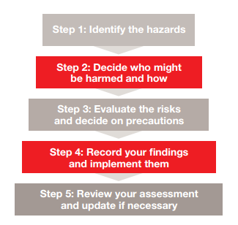



HSE 5 steps to risk assessment
How do I know if my RA is suitable and sufficient?
SFAIRP
Difficulty;
Time; and
Money

Slide 11
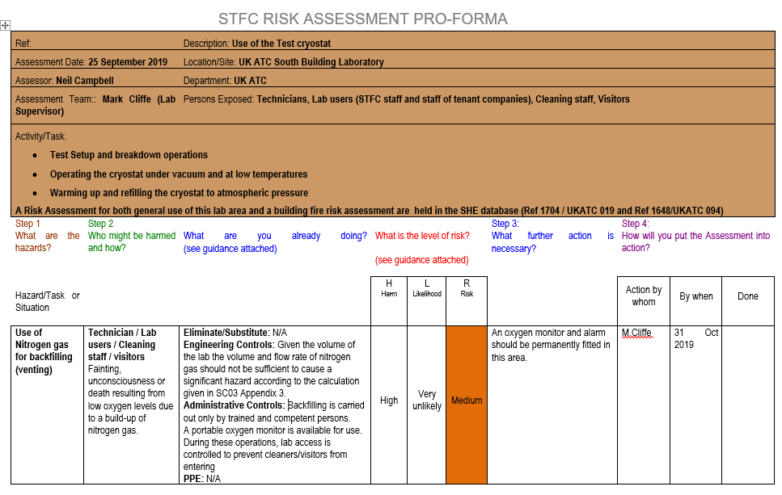
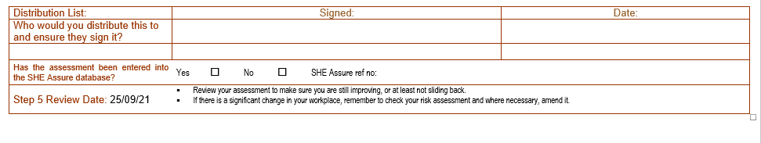
STFC Risk assessment proforma

Slide 12
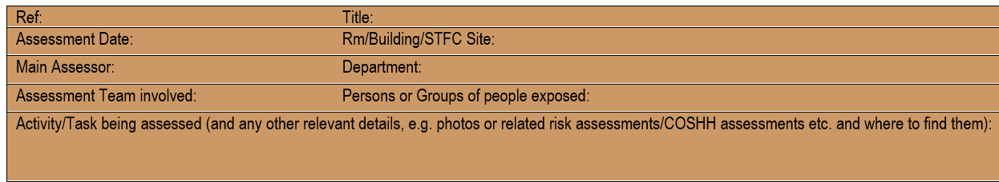
Setting the scene
Make it very clear what is being risk assessed
STFC has multiple sites, state which the RA applies to
Remember RA is a team effort, include the names of your team
Persons exposed: think in terms of groups of people
If Assessor leaves STFC, RA needs to be reviewed and name replaced with current member of staff
Any standards statements can be placed under ‘Activity/Task’, e.g.
          Fire hazards are covered by the building Fire Risk Assessment which is held on the Estates/SHE Database
          No lone working is allowed
          Access control is allowed to project member of staff only
          Add photo of equipment?
          A method statement accompanies this risk assessment

Slide 13


Who might be harmed and how?
Staff (trained and untrained)
Contractors
Visitors
Members of the public
Apprentices
Children (under 18s – gold plated)
People who share the workplace
People with disabilities (PEEP?)
Pregnant ladies or New Mothers
Night shift workers or ‘out of hours’ workers

Slide 14
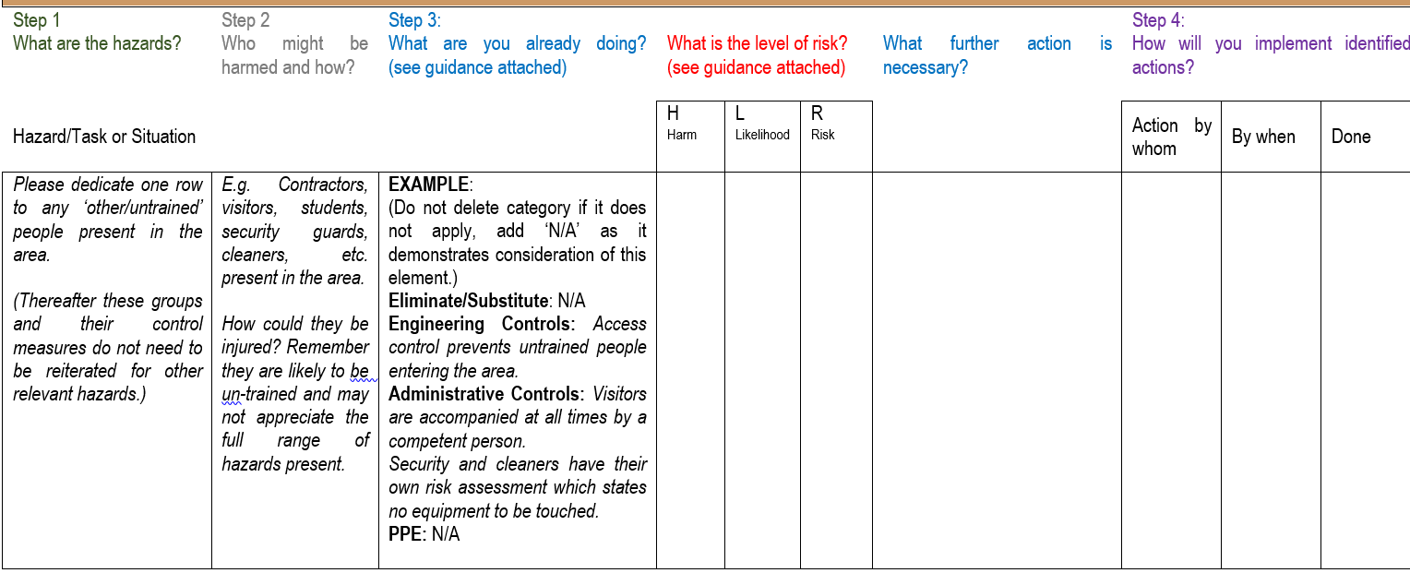
How to address other/untrained people in RA

Slide 15
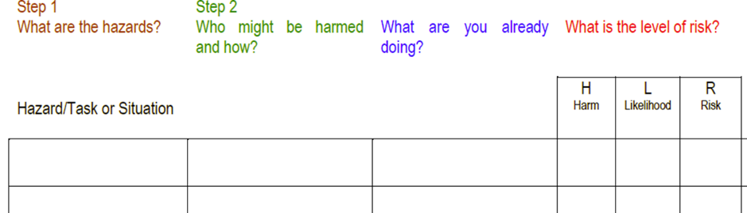

Risk Assessment - headings

Slide 16
STFC Risk assessment proforma

Slide 17
SHE Code 6: Risk Management (revised):
A HAZARD is anything that has the potential to cause harm. Types:
Physical safety hazards such as working with electricity or working from ladders
Health hazards such as working with hazardous chemicals, biological agents or allergenic materials. There are also, psychosocial hazards that could lead to work-related mental ill-health issues such as stress, anxiety or depression; or activities where staff may be subject to violence or aggression (e.g. front line, customer or public facing staff)
Environmental hazards such as activities leading to harmful emissions to atmosphere or contamination of our waste water systems

Slide 18

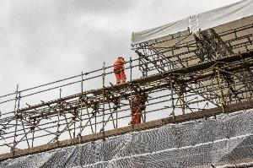

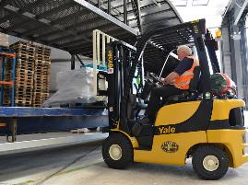


Definitions - Hazard
A hazard is any activity or object that has the potential to cause harm to people or the environment
Examples:
  Working at height
  Manual handling
  Working with syringes
  Driving a fork lift truck
  Operating 3D printer
  Use of mains electricity to power ‘x’ equipment
  Working with liquid nitrogen
  Working ‘out of hours’
  Working from home
Don’t just concentrate on safety hazards that can cause injuries or fatalities now. Remember health hazards, e.g. stress when project runs close to deadline, exposure to chemicals etc. which may cause lung damage which doesn’t show up for years.

Slide 19
Definitions
Harm (saying ‘injured’ is not sufficient)
  How the hazard could cause injury. In order to be specific, detail the pathway to the body, e.g:
    skin contact causing burns
    hit by projectile after explosion
    asphyxiation after inhaling nitrogen
    cut by sharp object
    absorbed through skin, etc.

Slide 20
STFC Risk assessment proforma

Slide 21
Hierarchy of control measures
1. Eliminate
Most
Preferred
2. Substitute
3. Engineering Controls
Least
Preferred
4. Administrative Controls
5. Personal Protective Equipment

Slide 22
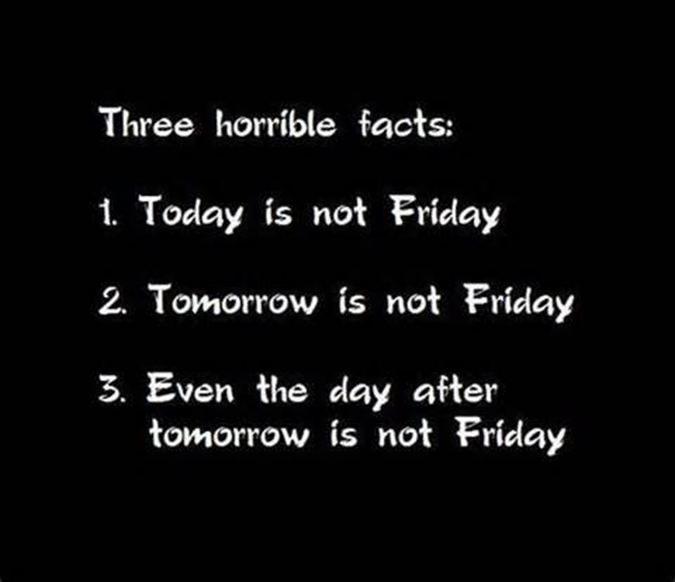
Language to describe control measures
Risk assessments are a factual account of what is in place to protect safety. Avoid use of words and phrases such as:
          Where possible staff will be provided with….
          On site training will have to be provided
          PPE such as safety shoes should be available
          Training will be reviewed monthly/quarterly/annually
A risk assessment is a statement of fact.
Think in black and white.
It either is or it isn’t

Slide 23
STFC Risk assessment proforma

Slide 24
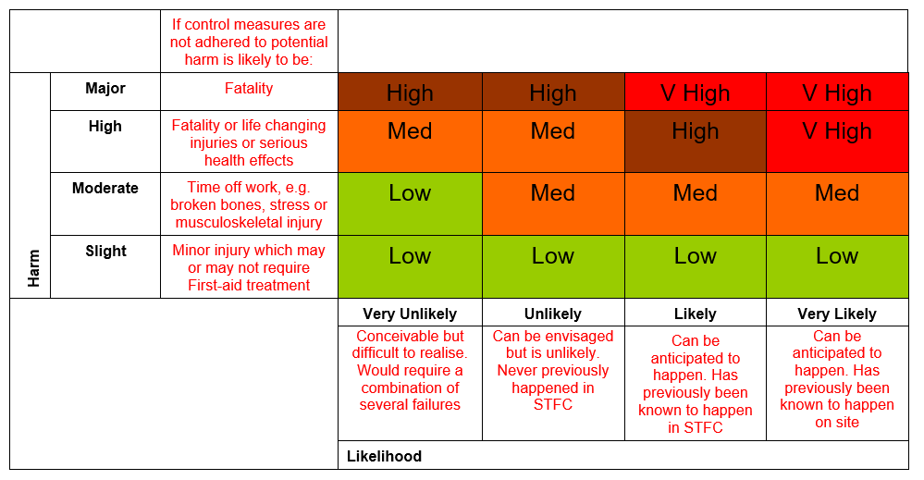
Priority matrix
  Risk is a function of both the harm and likelihood of a specific hazard being realised.

Slide 25
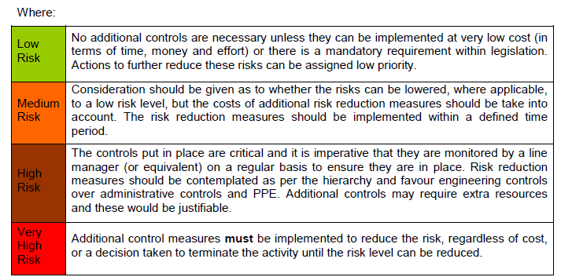
Definition of levels of risk

Slide 26
STFC Risk assessment proforma
Highest risk at the top

Slide 27
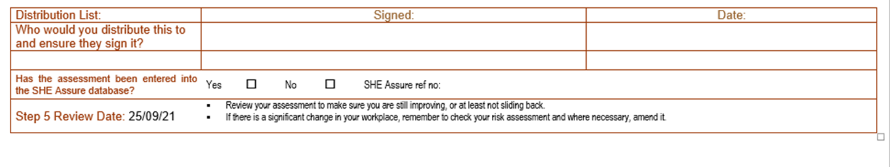
Final steps – remember remember the review date!
You can have the most wonderful risk assessments and policies in place but if they are not monitored and reviewed then they are worthless”
District Judge Taylor, Bristol Magistrates’ Court, July 2018
STFC policy is to review RAs every 2 years maximum. Unless there is an incident, e.g. near-miss or injury, if staff leave or any other material change.

Slide 28
STFC Risk assessment proforma
Further actions (added to Evotix Assure when adding RA, separate tab)

Slide 29
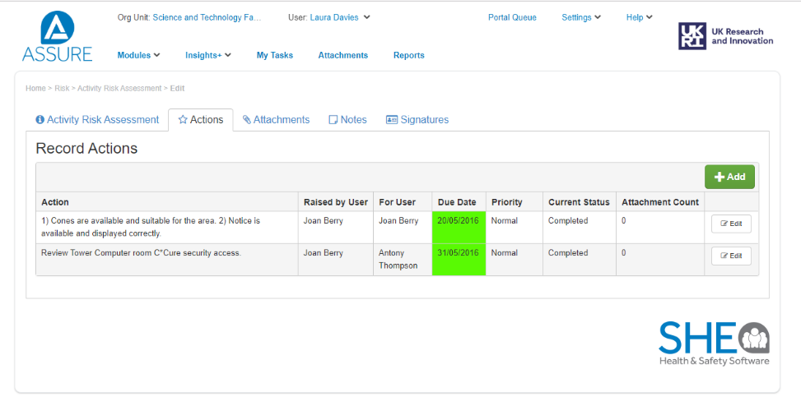
Evotix Assure

Slide 30
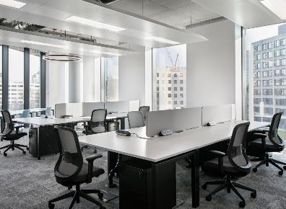
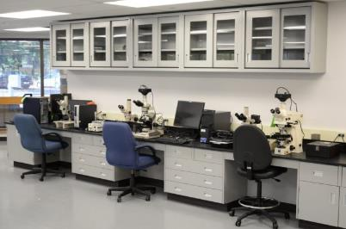
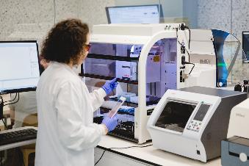
Common questions
When should I perform a generic risk assessment for a room with mixed use and when do I do a specific risk assessment for an activity?

Slide 31

HSE Guidance – is my RA suitable and sufficient
Have you included the 5 steps to RA?
Does risk assessment policy match what happens in reality?
Do you involve the workforce in the development of the RA?
  Asking for their views
  Seeking their suggestions
  Communicating RA to them once complete
Have control measures for the highest risks been incorporated into a regular monitoring scheme?
Should the implementation of control measures take time, have interim measures been put in place to minimise the risk?
New Appendix to the Code – Appendix 6 “Aide Memoire for the production of a “suitable and sufficient” RA

Slide 32
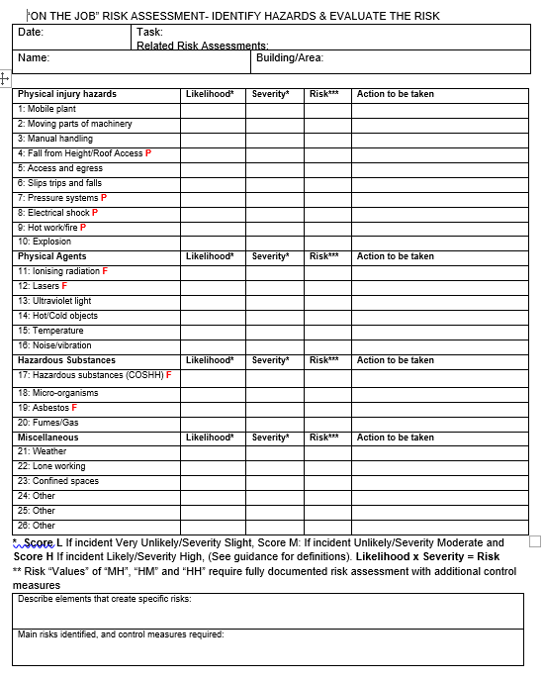
On the job risk assessment
For use when
  The task is a change or an addition to an existing planned activity
  A generic risk assessment needs to be adapted for a specific activity
Before starting the job, the assessor is required to STOP and THINK, can make use of a simple pro-forma designed to guide and record the risk assessment process
Part of this process is to check that a fully documented risk assessment is not required. If the work is deemed ‘high risk’ such as work at height then work will require to stop until a full documented RA is written and signed off

Slide 33

2016 Regime change: a new penalty landscape
In their first 6 months, the guidelines resulted in as many penalties of £1m or more as there were in the previous 20 years

Slide 34
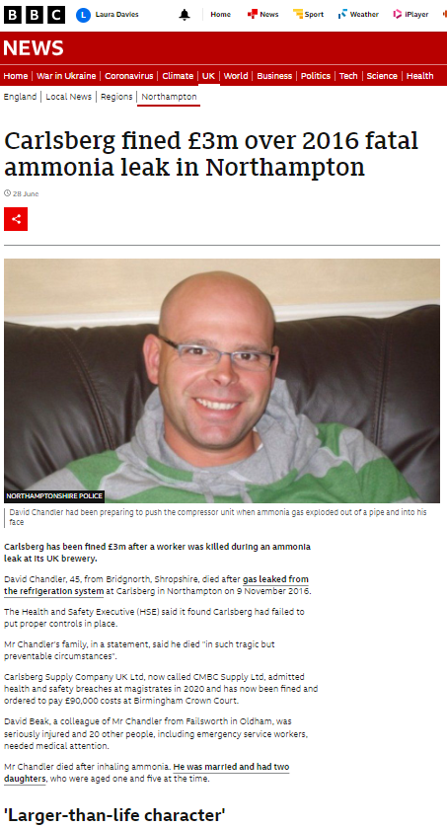
If a contractor is killed on our site it is ‘STFC’ name that will be reported
  David died almost instantly when exposed to highly toxic ammonia gas.
  One other was seriously injured and 20 people required hospital treatment.
  Carlsberg had hired Crowley Carbon to remove an old refrigeration system. It was during the removal of the compressor that there was an uncontrolled release of ammonia gas.
  Carlsberg were fined £3M and Crowley Carbon not a penny as they went into administration.

Slide 35


Statement from the HSE regarding Carlsberg incident
“Projects involving multiple contractors always require 'effective management arrangements for planning, managing and monitoring risks’. In this instance there were only 2 duty holders because Crowley Carbon was the principal designer and the principal contractor. It was not a complicated or difficult arrangement. This incident was entirely preventable – all Carlsberg and Crowley Carbon had to do look at the risk of ammonia gas and identify the correct standard of isolation required for this type of system. Had they done that, David Chandler would not have lost his life.
From the HSE’s point of view, it’s important that duty holders understand that in the case of an incident, the HSE will look to everybody with legal duties to determine if they have failed, and we will hold to account all those who do not comply with their legal duties.”

Slide 36
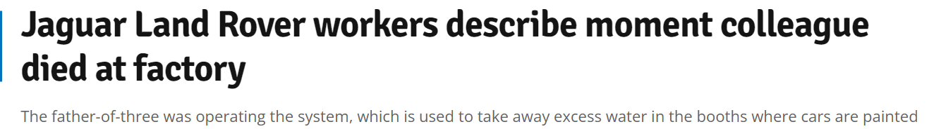
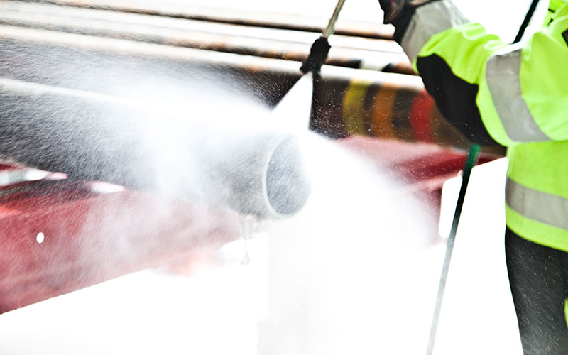

£2M fine and £30K costs.
In 2017, 38yr old father of 3, Joseph McDonald was a contractor working in the paint shop at Jaguar Land Rover's manufacturing site in Solihull. He was using a flexi-lance high-pressure water jet (20,000 psi) to remove excess water in the pipes of booths where cars are painted. The lance came out of pipe and struck him in the armpit causing excessive blood loss and he died at the scene.
Birmingham Magistrates’ Court was told that although Contractor Leadec Ltd, recognised the risks of operating high-pressure water jetting equipment, it had failed to put in place appropriate measures to mitigate the risks. The firm had not implemented or enforced the use of various control measures such as a pressure regulator or an anti-ejection device, which were missing at the time of the incident, and training and supervision were not sufficient.
HSE Inspector: “It is not good enough for companies to assume they are doing all they can to control the risk just because there have been no previous incidents. Joseph McDonald’s death could have been prevented had Leadec had the necessary control measures and management systems in place to protect its employees"
Notes:
He died on Fathers Day. RA said 3 people were expected to operate the machinery but only 2 were on this day. Joseph’s training had expired. Pressure should have been 13,500 psi. Person next to him shut the equipment off, no direct operated foot pedal.
Quite commonly accidents result in contact by the jet with an operator’s skin, causing an injury similar to a gunshot wound. When this occurs there’s also a high probability of infection because of contaminants being driven deep into the surrounding tissues.

Slide 37




Prosecutions
Wilko fined £2.2million after an incident at a Leicester store left a 20-year-old female worker paralysed, after a cage full of paint tins fell on her whilst she manoeuvred the heavy metal cage out from an uneven lift floor. There was no training or risk assessment in place.
Iceland fined £2.5million after worker fell almost 3m to their death through a ceiling at its Rotherham store. Contractor visited store to replace filters in an air conditioning unit. He fell from a platform just 45cms in width which had tripping hazards: cabling and fixing points for ladder itself. Iceland had not carried out a risk assessment to consider access to the plant platform either by staff or contractors. Previous staff had complained but nothing was ever done about it.

Slide 38

Method Statements (complex projects or working with contractors) “RAMS”
Task description
Known hazards
Responsible people
How projects will be monitored
Structure of tasks
Environmental issues
Permits
Competency of workers
Deliveries
Emergency Arrangements
See Appendix 7 of Code 6 for info on Method Statements and Safe Systems of Work

Slide 39
SHE Code 6: Risk Management (revised):
Recent changes:
Mental risk assessments (RA) for occupational activities have been discouraged in favour of documented RA’s
On-the-job pad RA’s are to be used only for last minute alterations to documented RA’s, or low risk dynamic activities when a documented RA is not possible
Definition of hazard has been expanded
Risk matrix altered to re-define high risk
RA proforma updated to include a prompt for the hazard of ‘untrained personnel in the area’
Training required for anyone carrying out or reviewing RA’s

Slide 40

Thoughts to leave you with….
Common problems with risk assessments:
Confusing hazard (potential) with outcome. Nothing painful in 1st column!
Failure to consult staff on preparation of RA or brief them on completion.
Not taking into consideration everyone potentially impacted by the activity.
Relying on a “generic” risk assessment when a “specific” one is needed.
Failure to complete the risk calculation correctly.
Insufficient information for high risk activities. Level of detail should be proportionate to the risk.
Failure to take account of individuals’ requirements.
Lack of clarity on responsibilities – especially in matrixed projects.

Slide 41
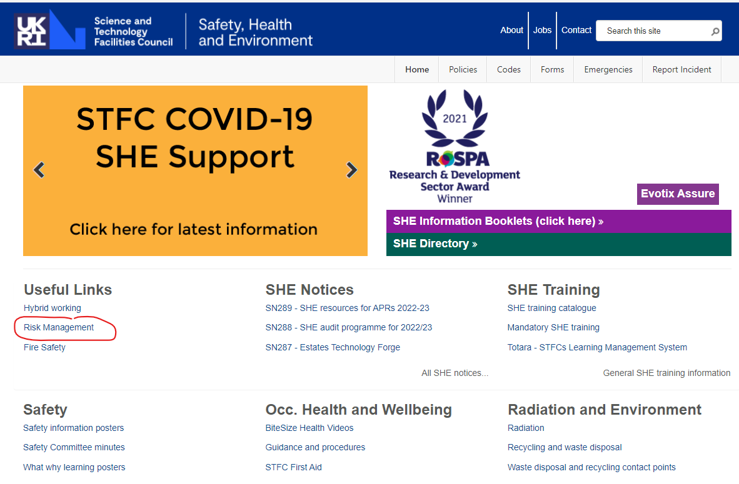
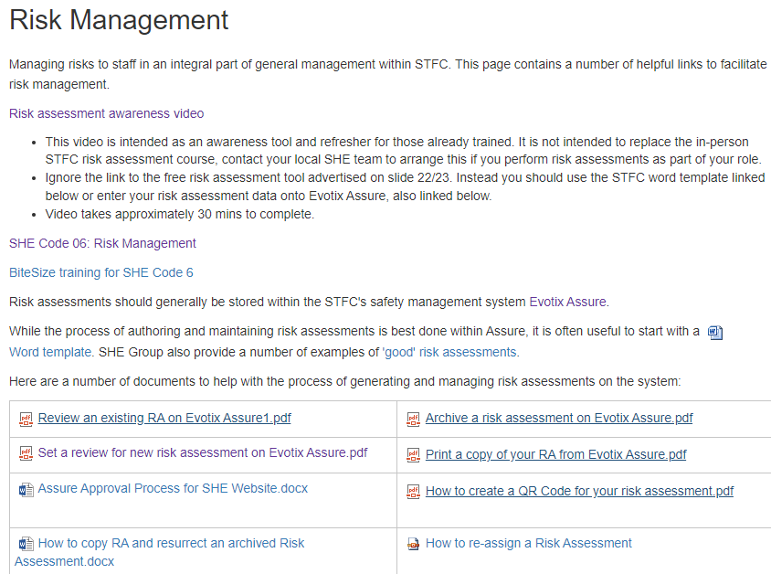
Dedicated risk assessment page
Please bookmark the SHE website on your PC/laptop, it’s a one stop shop for all SHE related topics:
https://staff.she.stfc.ac.uk/pages/staff/home.aspx

Slide 42
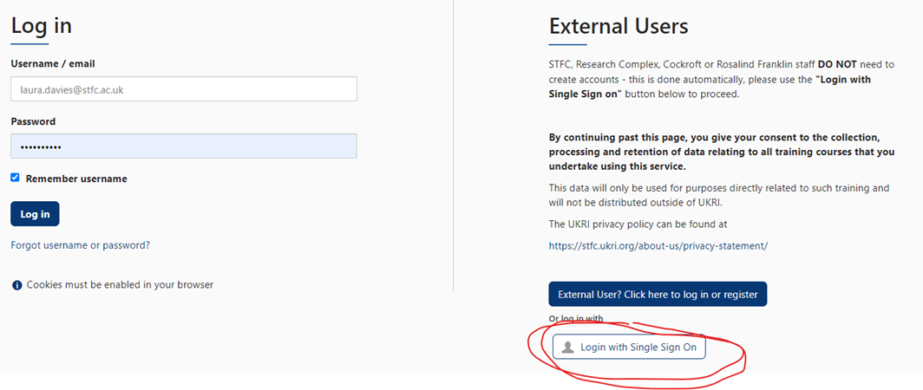
Logging onto Totara
Clicking on ‘Single Sign On’ will take you direct to your course when you follow a link
Having problems?
Ensure your VPN is connected.

Slide 43
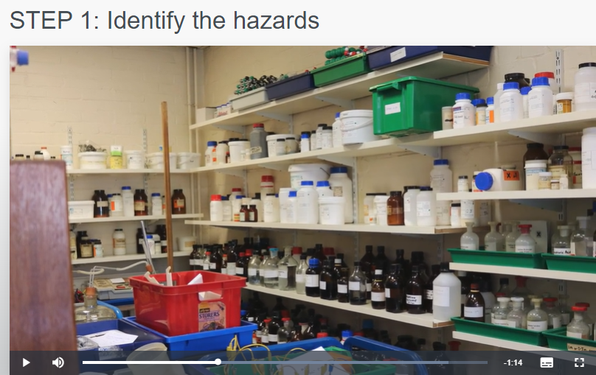
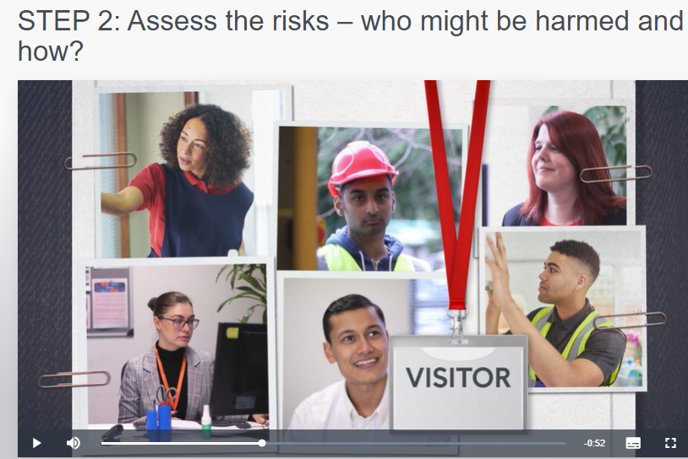
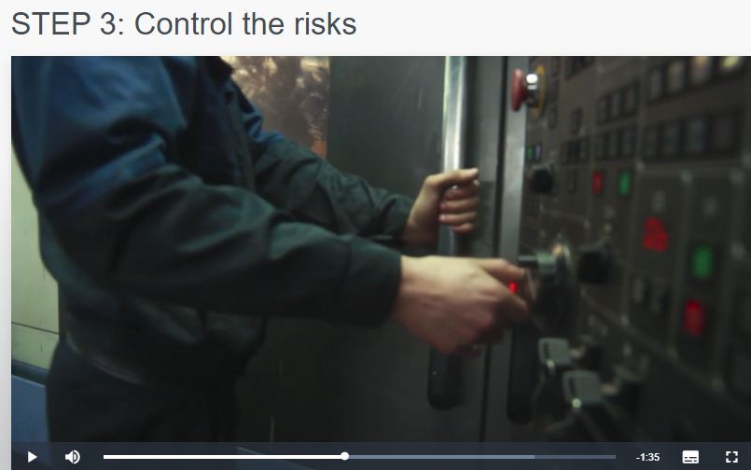
Risk Assessment Awareness

Slide 44
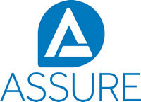
Evotix Assure Demo
Risk Assessment

Slide 45
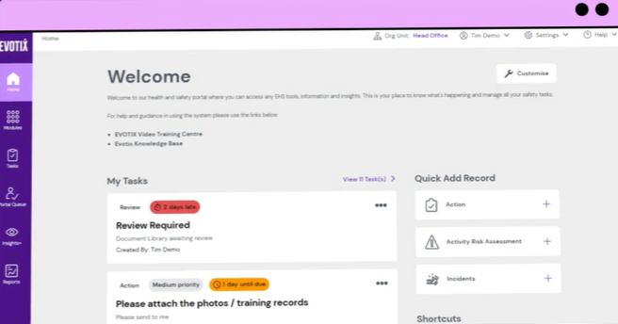
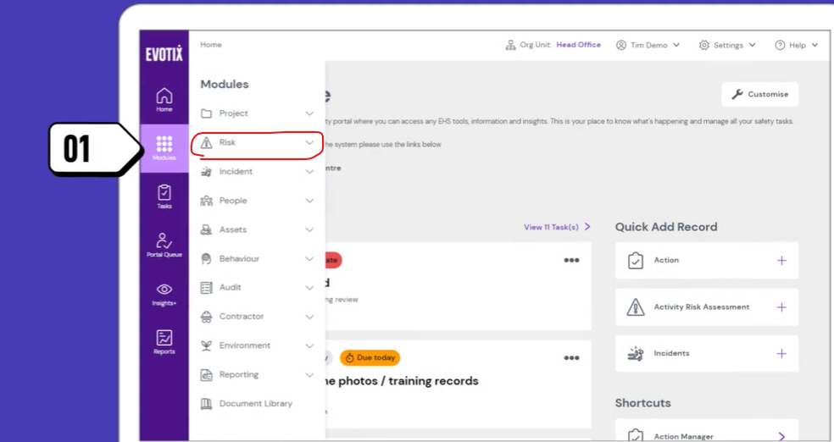
EVOTIX ASSURE: NEW LOOK DASHBOARD LAUCHES 13TH SEPT 2022

